Slide 1
Ut0418fsf5eva:
Bootcampspot’s Revenge

Slide 2
BUH!
I am the Great Pumpkin
I am here because I love to give a fright.
You can find me at @halloween

Slide 3
Dreadful Transition Headline
Let’s start with the first set of slides

Slide 4
“Quotations are commonly printed as a means of inspiration and to invoke frightful thoughts from the reader”

Slide 5
This is a slide title
Here you have a list of items. Nice bullets, ah?
And some bloodcurdling text
But remember not to overload your slides with content
You audience will listen to you or read the content, but won’t do both.

Slide 6
MACABRE CONCEPT
Bring the fear of your audience over a key concept using icons or illustrations

Slide 7
You can also split your content
White
Is the color of ghosts and vampire skin, the color produced by the combination of all the colors of the visible spectrum.
Black
Is the color of bats, witch clothes, and of enchanted cats. It is the darkest color, the result of the absence of or complete absorption of light.

Slide 8
In two or three columns
Orange
Is the color of pumpkins. The colour orange is named after the appearance of the ripe orange fruit.
Purple
Is the colour of dusk before the dark night comes. Is the color most often associated with royalty, magic, and mystery.
Red
Is the color of blood, and because of this it has historically been associated with sacrifice, danger and courage.

Slide 9
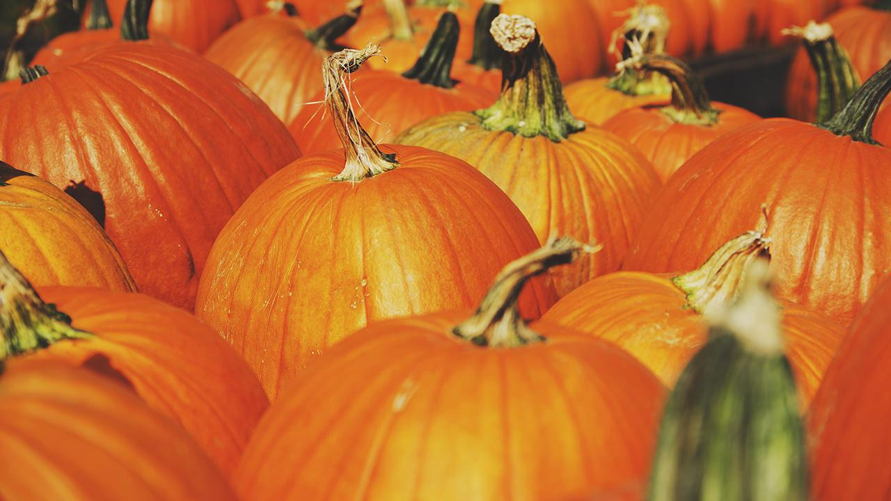
A picture is worth a thousand words
A complex idea can be conveyed with just a single still image, namely making it possible to absorb large amounts of data quickly.

Slide 10
Trick or treat?
ANYCASE, USE BIG IMAGE

Slide 11
Use scary charts to explain your ideas
Purple
Black
White

Slide 12
And magic tables to compare data
 | A | B | C
Yellow | 10 | 20 | 7
Blue | 30 | 15 | 10
Orange | 5 | 24 | 16

Slide 13
Thrilling Maps
our office

Slide 14
89,526,124
Whoa! That’s a big scary number, aren’t you frightened?

Slide 15
89,526,124 treats
185,244 frights
100%
That’s a lot of sugar
And a lot of fear
Total success!

Slide 16
Our process is easy
trick or treat?
candies
stomach ache

Slide 17
Let’s review some mysterious concepts
Orange
Is the color of pumpkins. The colour orange is named after the appearance of the ripe orange fruit.
Purple
Is the colour of dusk before the dark night comes. Is the color most often associated with royalty, magic, and mystery.
Red
Is the color of blood, and because of this it has historically been associated with sacrifice, danger and courage.
Orange
Is the color of pumpkins. The colour orange is named after the appearance of the ripe orange fruit.
Purple
Is the colour of dusk before the dark night comes. Is the color most often associated with royalty, magic, and mystery.
Red
Is the color of blood, and because of this it has historically been associated with sacrifice, danger and courage.

Slide 18
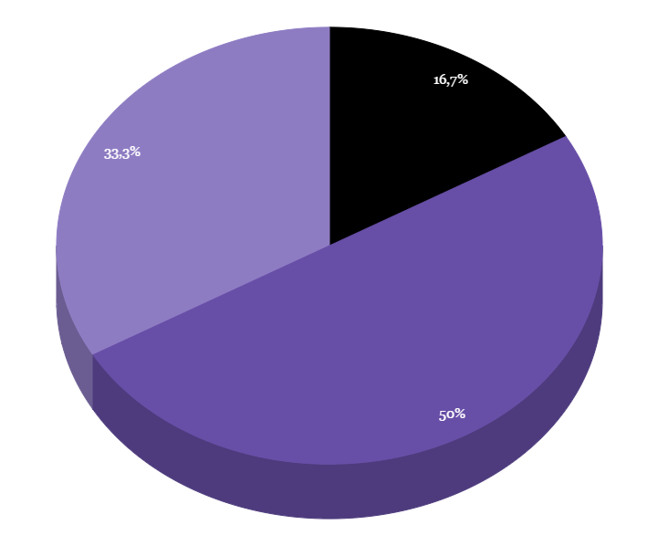
You can copy&paste chilling graphs from Google Sheets

Slide 19
Android project
Show and explain your web, app or software projects using these gadget templates.
Place your scary screenshot here

Slide 20
iPhone project
Show and explain your web, app or software projects using these gadget templates.
Place your scary screenshot here

Slide 21
Tablet project
Show and explain your web, app or software projects using these gadget templates.
Place your scary screenshot here

Slide 22
Desktop project
Show and explain your web, app or software projects using these gadget templates.
Place your scary screenshot here

Slide 23
Happy Halloween!
Any questions?
You can find me at @halloween

Slide 24
Credits
Special thanks to all the people who made and released these awesome resources for free:
Presentation template by SlidesCarnival
Photographs by Unsplash

Slide 25
Presentation design
This presentation uses the following typographies:
Titles: Mountains of Christmas
Body copy: ABeeZee
You can download the fonts on these websites:
https://www.fontsquirrel.com/fonts/mountains-of-christmas
https://www.fontsquirrel.com/fonts/abeezee
You don’t need to keep this slide in your presentation. It’s only here to serve you as a design guide if you need to create new slides or download the fonts to edit the presentation in PowerPoint®

Slide 26

SlidesCarnival icons are editable shapes.
This means that you can:
Resize them without losing quality.
Change fill color and opacity.
Isn’t that nice? :)
Examples:

Slide 27

Halloween extras

Slide 28
😉
Now you can use any emoji as an icon!
And of course it resizes without losing quality and you can change the color.
How? Follow Google instructions https://twitter.com/googledocs/status/730087240156643328
✋👆👉👍👤👦👧👨👩👪💃🏃💑❤😂😉😋😒😭👶😸🐟🍒🍔💣📌📖🔨🎃🎈🎨🏈🏰🌏🔌🔑 and many more...

